Slide 1
Applied Data Science Capstone project
Optimizing Payload Pricing for Rocket Launches: A Data Science Approach

Slide 2
Cover Page
Rocket launches are complex and costly endeavors, with success hinging on precision, technology, and resource optimization. With Falcon 9, one of SpaceX's leading rockets, our project aims to develop a data-driven model to determine the most optimized payload price while minimizing financial losses and maximizing launch success. Through this model, we seek to enhance cost-efficiency in space missions by aligning payload costs with predicted mission outcomes and risk factors.

Slide 3
Executive Summary
This project addresses the challenge of optimizing payload pricing for rocket launches, a crucial factor in reducing overall mission costs and enhancing the viability of space missions. By examining SpaceY’s Falcon 9 launch data, we aim to develop a data-driven model that predicts optimal payload pricing while minimizing financial losses associated with launch risks and failures.
Using advanced data science techniques, including machine learning and statistical analysis, our approach analyzes historical launch data to identify patterns that impact launch success and pricing efficiency. Key features such as payload mass, launch location, and mission type are considered to predict the price point at which profitability and success likelihood are maximized.
The outcome of this analysis provides an optimized pricing strategy that aligns with risk mitigation, supporting more cost-effective and reliable space missions. This model has potential applications across the aerospace industry, contributing to more sustainable practices in mission planning and budgeting.

Slide 4
Table of Contents
Introduction
Methodology
Results
Discussion
Conclusion
Appendix

Slide 5
Introduction
In this Data Science project, Space Y aims to determine the optimal launch site for the Falcon 9 rocket to enhance operational efficiency and reduce costs. By analyzing launch data collected from SpaceX's websites, we created a comprehensive dataset, which was meticulously cleaned and preprocessed, including the removal of null values. Through data exploration and model optimization, we refined key metrics to meet the project's objectives, enabling more informed decision-making for future launches and improved cost-effectiveness for Space Y's Falcon 9 operations.

Slide 6
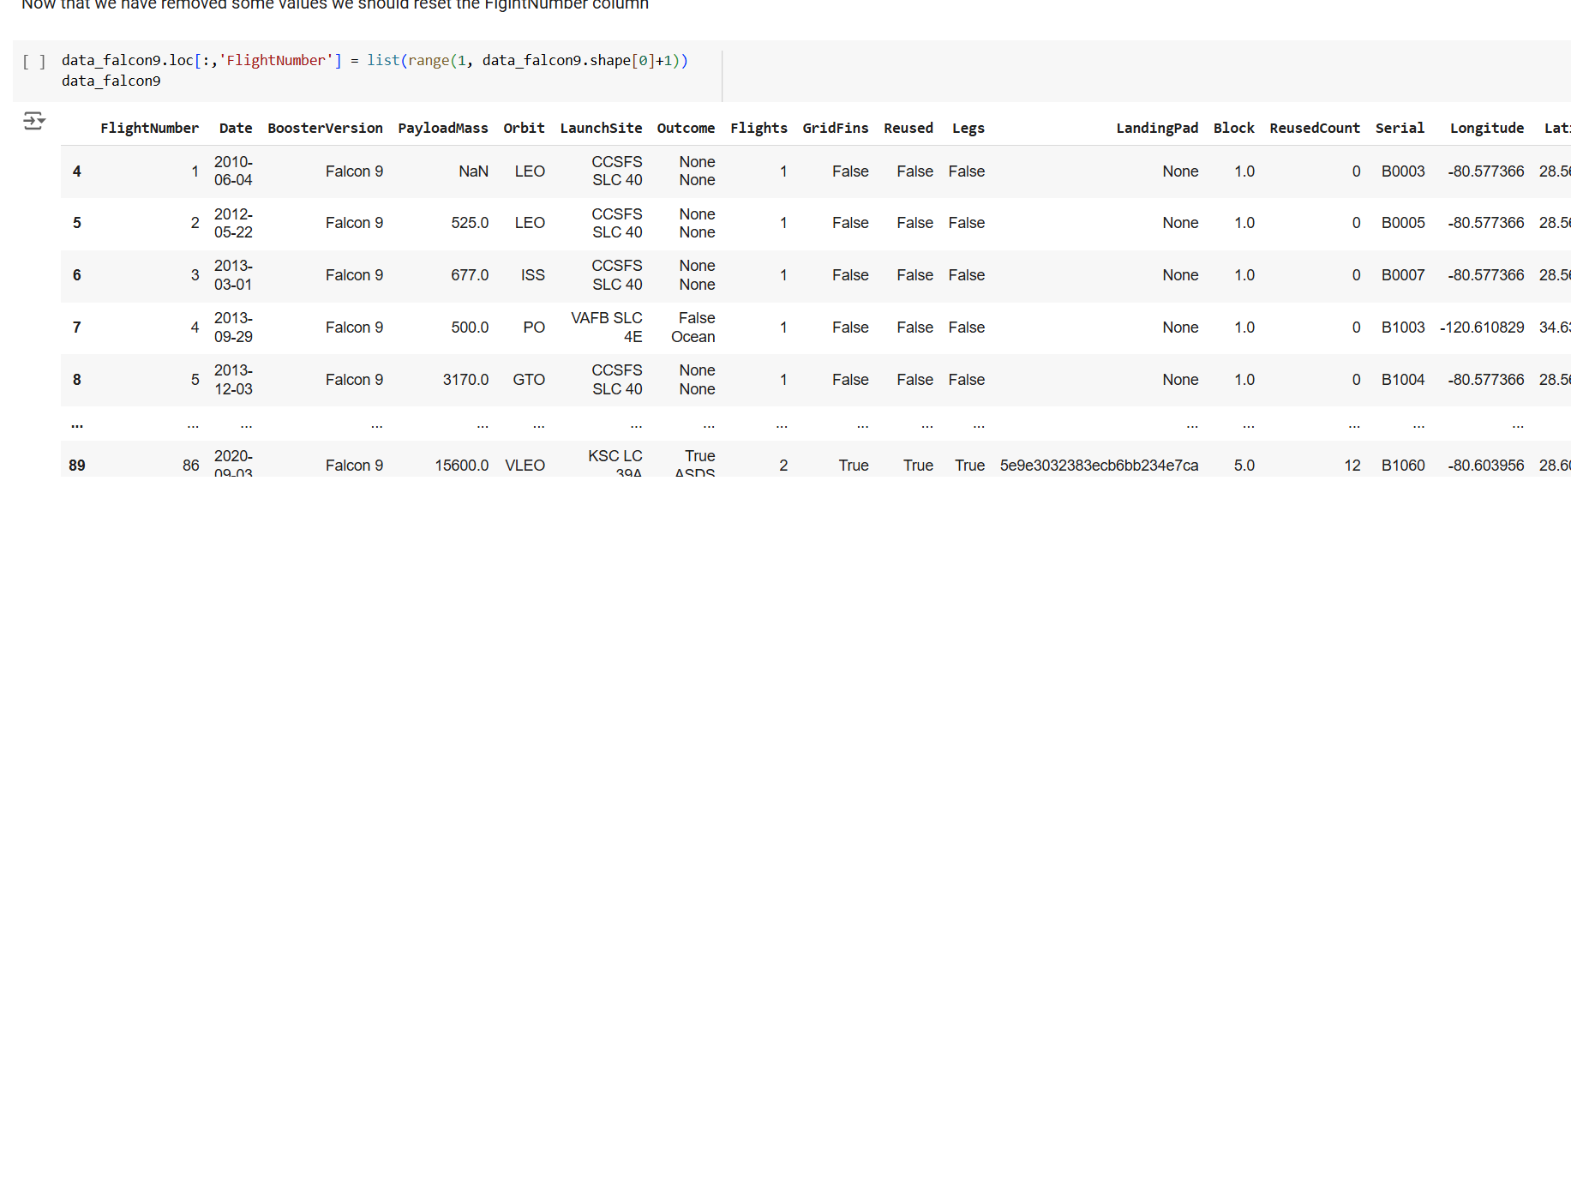
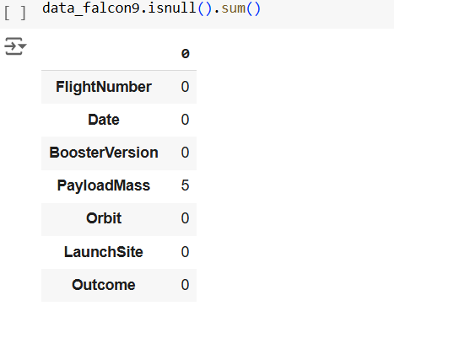
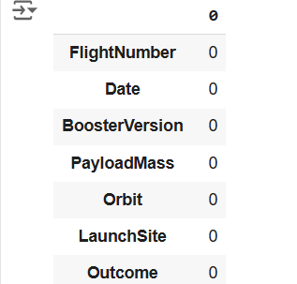
DATA COLLECTION AND ANALYSIS

Slide 7
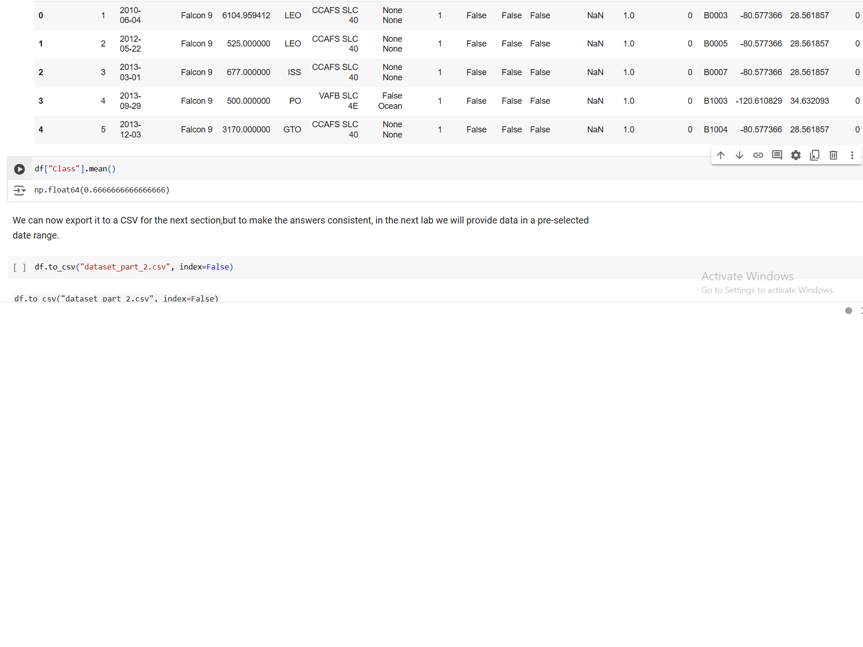
DATA WRANGLING AND METHODS

Slide 8
Methodology
The objective of this project is to identify the optimal launch sites for achieving successful Falcon 9 launches based on historical data. To achieve this, a classification approach was used to determine the probability of launch success at each site. Classification is ideal here as it allows us to categorize launches into successful or failed outcomes, providing clear insights into the factors associated with success.
We separated the data into independent and dependent variables, splitting them into training and test sets with a 20:80 ratio. Various classification methods, including Logistic Regression, SVM, Decision Tree, and KNN classification, were employed. Each model was evaluated based on accuracy, F1 score, and recall, allowing us to compare performance and select the best approach for maximizing launch success.

Slide 9
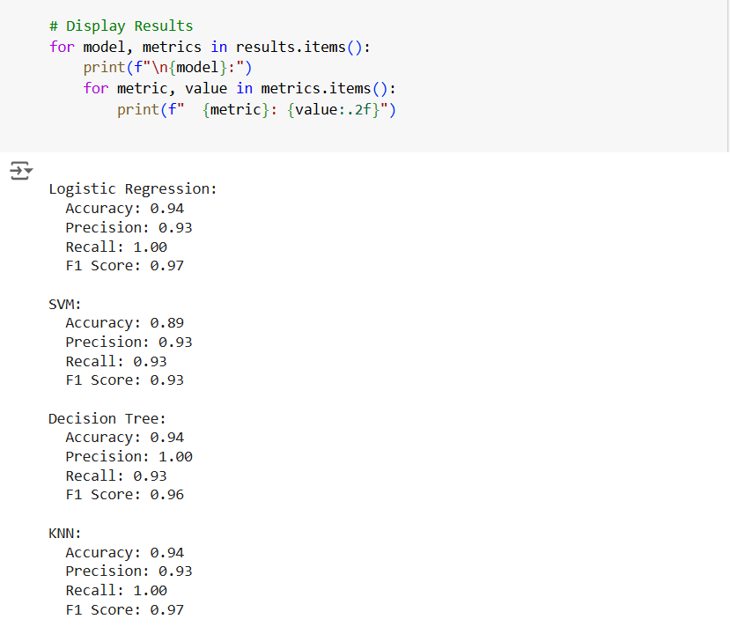
MODEL EVALUATION AND ITS RESULTS

Slide 10
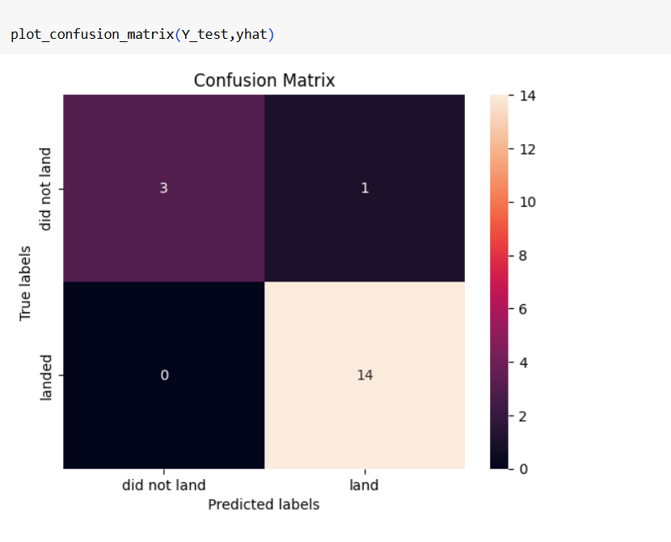
CONFUSION MATRIX FOR DECISION TREE MODEL

Slide 11


RESULTS AND GRAPHS

Slide 12


ANALYZING ROCKET LAUNCH SITES USING PIE CHARTS IN DASH

Slide 13
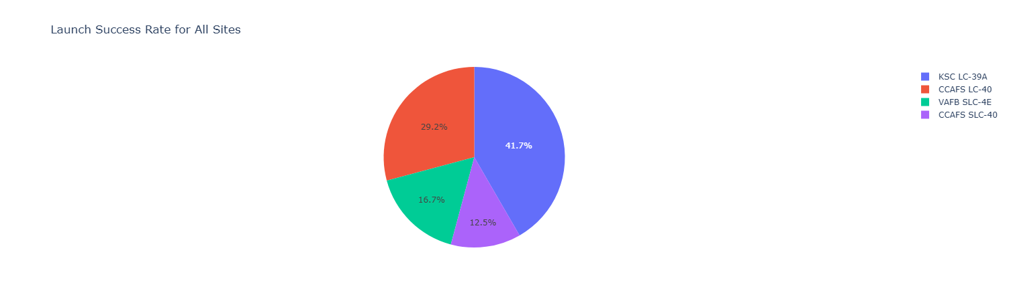
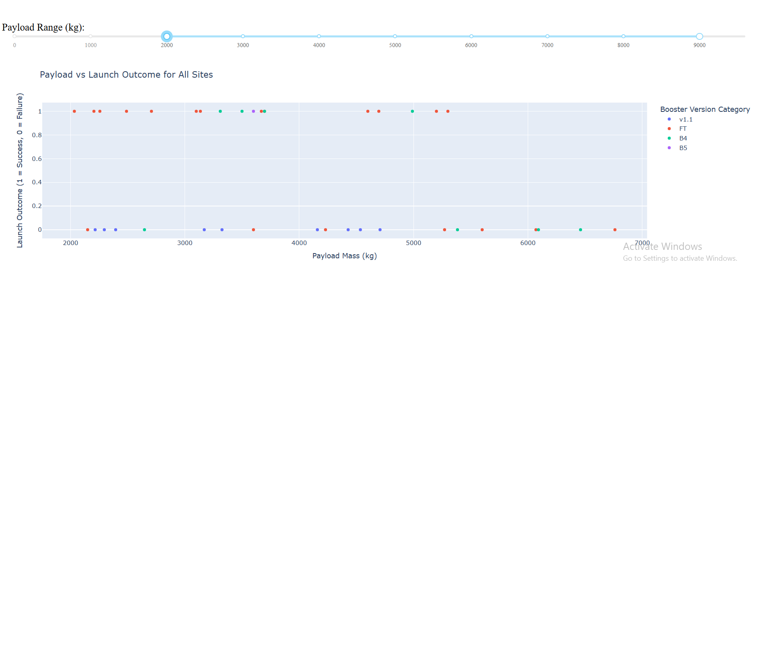
PIE CHART AND SCATTER PLOT ANALYSIS

Slide 14
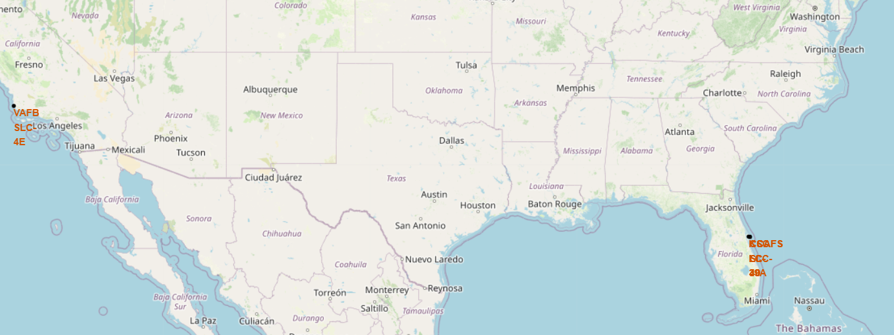
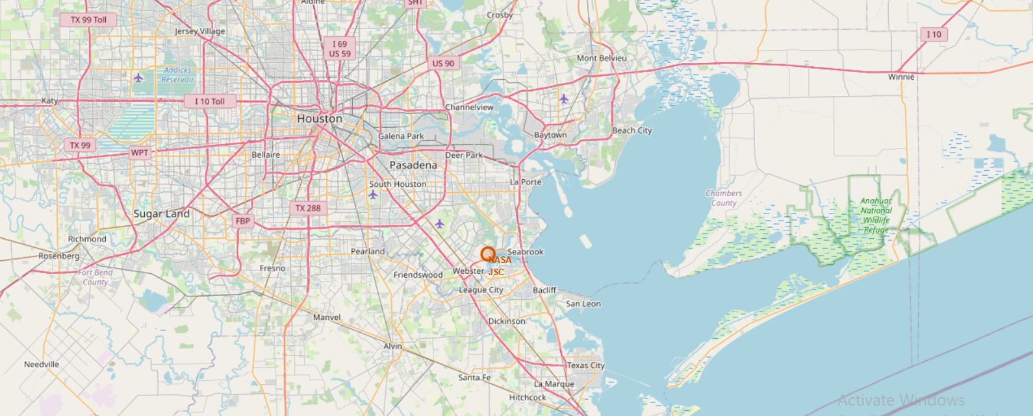
LAUNCH SITES GENERATED USING FOLIUM

Slide 15
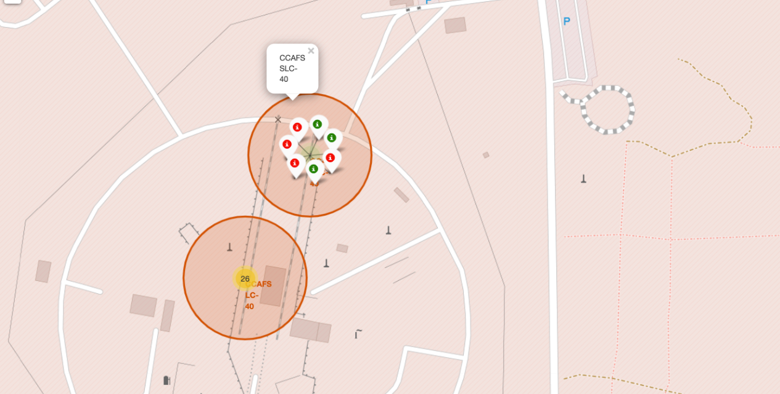
SUCCESS AND FAILURE LOCATION OF LAUNCH SITE CCAFS SLC-40

Slide 16
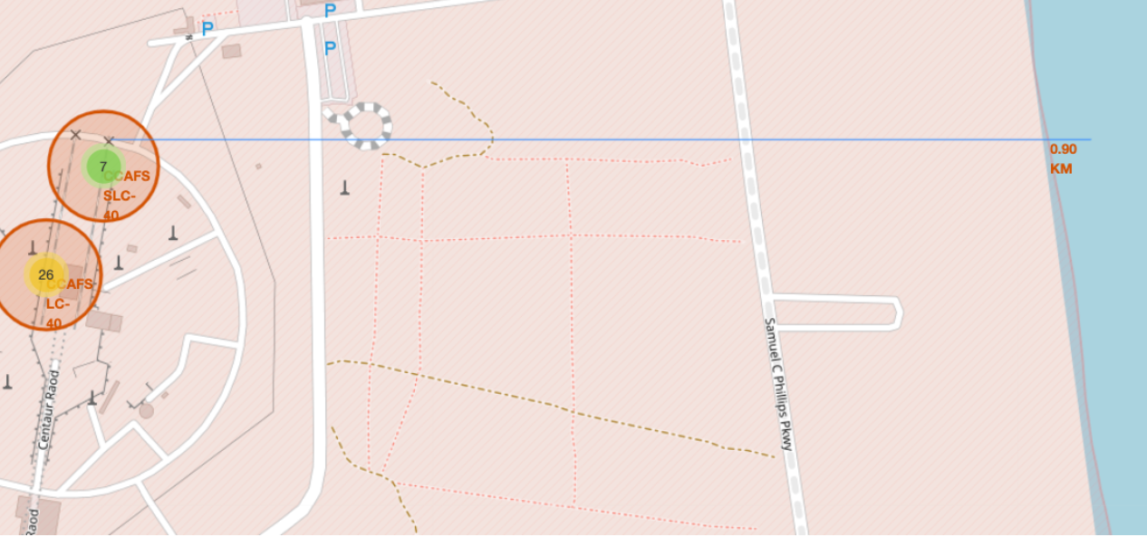
CALCULATION OF DISTANCE BETWEEN LAUNCH SITE AND COASTLINE

Slide 17
DISCUSSION
Proximity to Transportation Infrastructure: Launch sites are located close to NASA railroads, providing cost-effective transportation of rocket parts to the launch area, enhancing logistical efficiency.
Strategic Coastal Positioning Near the Equator: Sites are positioned near the coastline close to the equator. This location is ideal for launching rockets due to the Earth’s rotational speed, which provides an additional velocity boost, reducing the fuel required to reach orbit. In case of a malfunction, rockets can be safely diverted to the ocean, minimizing risks to populated areas.
Distance from Cities: Launch sites are purposefully located far from cities to ensure safety, reduce noise disruptions, and enable smoother operations with minimal interference.

Slide 18
CONCLUSION
The best model for predicting a successful launch site should incorporate these discussed factors: proximity to reliable transportation infrastructure, coastal equatorial positioning for efficiency and safety, and distance from populated areas. These factors collectively enhance logistical, operational, and safety outcomes for rocket launches. In this project, we determined that the best model for predicting the success rate of rocket launches is based on the K-Nearest Neighbors (KNN) classification algorithm

Slide 19
APPENDIX
https://github.com/Aruna2897/IBM_Data_science_course_assignments
https://github.com/Aruna2897/IBM_Data_science_course_assignments/commit/a386e53069810f912ec99c1542aff617f109c9c8
https://github.com/Aruna2897/IBM_Data_science_course_assignments/commit/a386e53069810f912ec99c1542aff617f109c9c8#diff-5020ebb2d5dc3e3a9957ee6692ac054ba0ddcce89e81035daf3f5768aa57c3b6

